Slide 1
C2P India
QA Track
TVA/BVA Overview & Hands-On

Slide 2
Agenda
TVA – Overview & Walkthroughs
Question and Answers
BVA – Overview & Walkthroughs

Slide 3
Agenda
TVA – Overview & Walkthroughs
Question and Answers
BVA – Overview & Walkthroughs

Slide 4







OPF Testers View – A Case Study (On Us Payment)
MT103 (50 EUR)
MT103 (50 EUR)
Mr. Edward
Debit Party
Barclays, UK (BARCGB22)
Debit Party Agent
Mrs. Elaine
Credit Party
XCT BANK-1, Belgium
(XCTABEBB)
Credit Party Agent
Mr. Edward wants to transfer 50 EURO to Mrs. Elaine.
Mr. Edward have an Account at Barclays Bank while Mrs. Elaine have an Account at XCT Bank -1.
Mr. Edward initiates a Payment via Mobile Banking, Internet Banking or Cheque Transfer.
Barclays Bank process the request from Mr. Edward while debiting his account with 50 Euro and crediting 50 Euro in its Internal Account.
Barclays Bank, to narrate this whole story, creates & send a message MT103 over SwiftGateway.
From its Internal Account, Barclays Bank transfers the amount in XCT Bank -1’s Vostro Account at Barclays Bank.
SwiftGateway validate the file and forward it to be received by XCT- Bank-1.

Slide 5
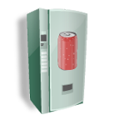
TVA - Test Visibility Application
MT103 (50 EUR)
TVA
XCT BANK-1, Belgium
(XCTABEBB)
Credit Party Agent
TVA is a Test Driver which allow a tester to exercise/examine in a controlling manner the unit of software being tested (in this case the Bank Visibility Application)
Thus we can call it as an entry point which mimics the behavior of real environment to allow the Payment message file to be entered in the system for processing.

Slide 6
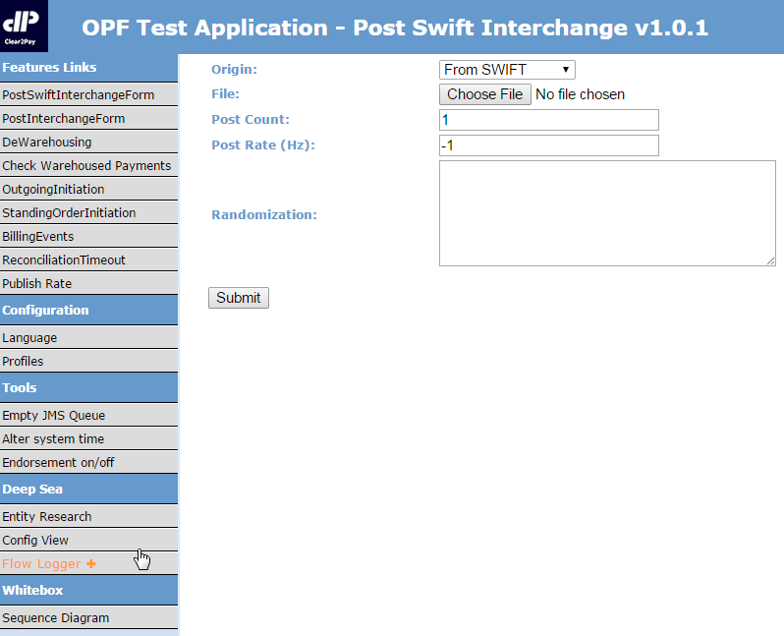
TVA - User Interface

Slide 7
TVA - Frequetly Used Functionalities
Post Swift Interchange Form
Post Interchange Form
Alter system time
Endorsement
Config View
Flow Logger

Slide 8
TVA - Test Visibility Application
MT Swift Format (*.txt)
ISO Format (*.xml)
Proprietary
Gateway
TSV Format (*.tsv)
TVA
The incoming file from the payment governing body towards bank can be of different types:-
MT Swift Format (*.txt)
ISO - 20022 Format (*.xml)
Proprietary Format (*.tsv)

Slide 9
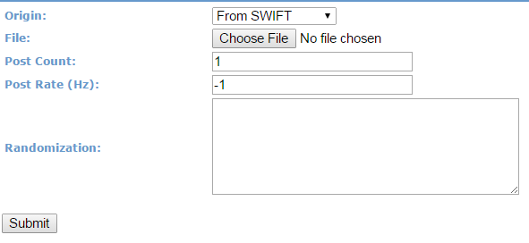
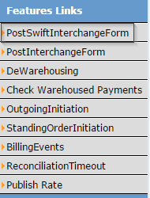
TVA - Post Swift Interchange Form
The PostSwiftInterchangeForm is used for uploading the Swift MT (*.txt) type messages into the system.
Origin - From Swift (so as to reflect that the payment is coming ‘From Swift’).
Browse and select the file (may be lying locally).
Post Count/ Post Rate/ Randomization - They can be kept unchanged as they are only useful for advanced Non Functional Tests.
Submit - It will place the incoming file in the queue to be further processed by the system.

Slide 10
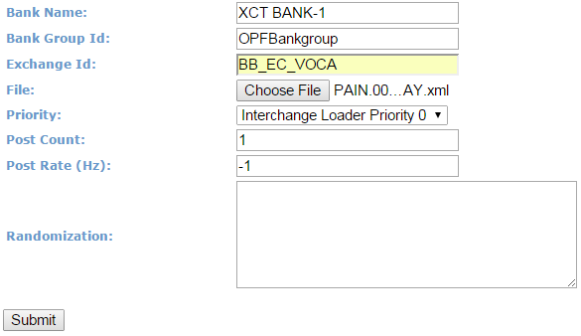
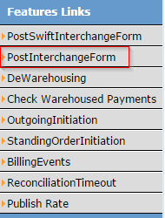
TVA - Post Interchange Form (1)
The PostInterchangeForm option is used for uploading the Swift ISO / MX (*.xml) type messages.
Bank Name - Accepts the name of receiving bank, mentioned in the Payment file.
Bank Group Id - Accepts the BankGroup name of receiving bank.
Since OPF can be configured as a multibank / multi bank group environment, we need to indicate both the bank group (Bank Group Id) and the bank (Bank Name). The combination of the two parameters tells exactly which bank to use to process the file.

Slide 11
TVA - Post Interchange Form (2)
Exchange ID - An Exchange Condition contains information about the clearing process and exchange of information between the OPF Bank and one of the Participants it interacts with.
File - Browse and select the file (may be lying locally).
Submit - It will place the incoming file in the queue to be further processed by the system.

Slide 12
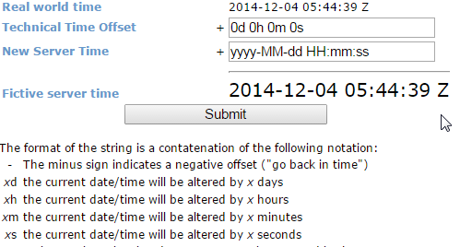
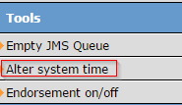
TVA - Alter System Time
It is a function that changes the date on the test application server, used to advance or go back in time.
This enables user to test functionalities, for e.g. De-Warehousing, Time Line Validations.
Tests where rather than waiting for days (or even months and years) for the correct time-lapse, it is possible to test on the same day (or even possible in the case of tests that require significant timescales).

Slide 13
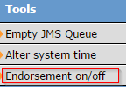
TVA - Endorsement On/Off
At certain point of time it is required to Add/Edit/Delete some part of the configuration of the bank application, like adding New Bank User, Modifying new participant, etc...
These are critical functionalities from a bank set up perspective and thus can not be added just by one person on a go and would require discretion of an authorized person.
If the Endorsement is ON then any configured change in BVA that requires to be endorsed should be approved/endorsed by another Authorized entity.
Default value for Endorsement is set as True, while a new build is arrived, but can be turned on through TVA, or can be defaulted to False by implementation team.

Slide 14
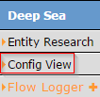
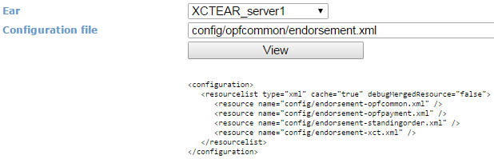
TVA - Deep Sea (Configuration View)
This functionality is to help tester to refer/view the content of the various configuration files that are a part of the application.

Slide 15
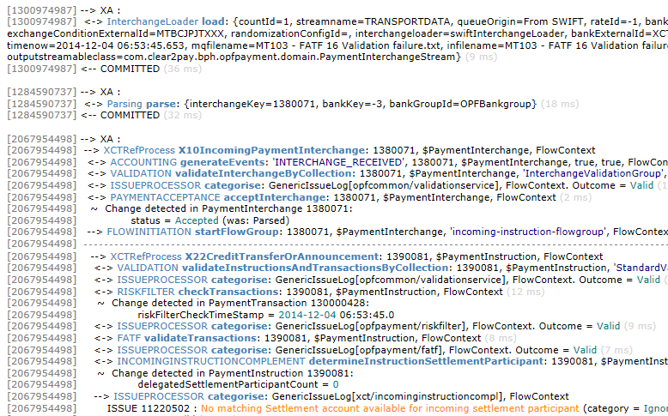
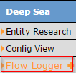
Deep Sea – Flow Logger
This is used to see the real time logs that are being recorded while an activity is performed over the application.
For e.g. to see any unexpected behavior while a service is being invoked.

Slide 16
Agenda
TVA – Overview & Walkthroughs
Question and Answers
BVA – Overview & Walkthroughs

Slide 17
BVA - Bank Visibility Application (1)
BVA
The Bank Visibility Application (BVA) is a web-based platform that provides an end-to-end environment for electronic payments used with OPF. BVA provides functionality to Bank Users to, amongst other things:
- Setup and maintain Bank information including:
Banks and Departments
Users
Bank User Accounts, Bank User Roles
Routing Rules …
- Manage Payments including:
Search and view Interchanges, Instructions and Transactions
View Work list Items
View Audit Logs
User Interface to Create/Repair/Approve Payments …

Slide 18


BVA - Bank Visibility Application (2)
Pass
BVA
Interchange Loader
Look for errors in System logs
TVA
Fail
BVA is a visual representation of the application.
The services that a payment message undergoes, before it finally comes into the system is Interchange Loader .
Before a message content can actually be visualized in BVA, a successful result from these services should happen.
If a failure happens then the underlying reason can only be seen in the System Error Logs. So if you upload a file & you don’t find it in BVA, then you should go to System Logs to verify the root cause of failure (which is actually Invalid File).

Slide 19
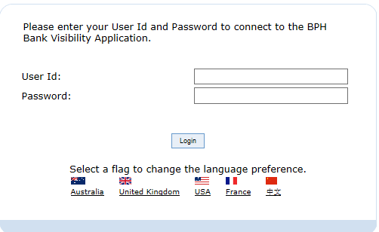
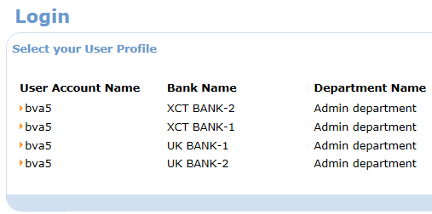
BVA - UI (Login Screen)

Slide 20
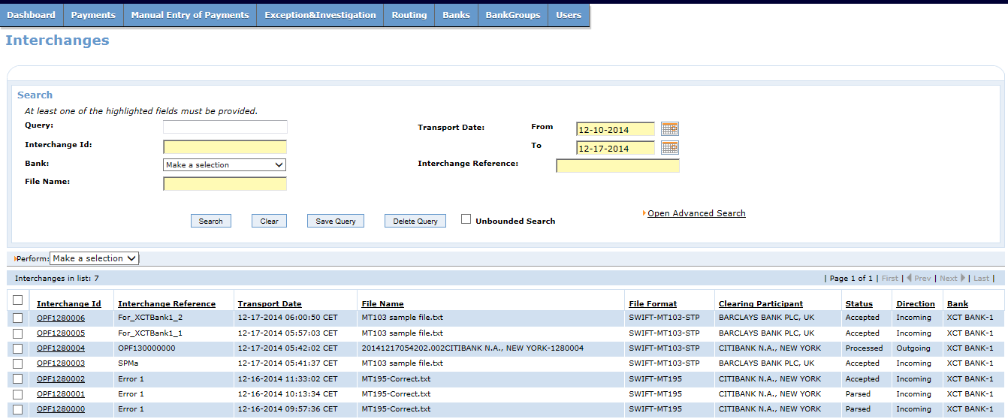
BVA - UI (Interchange Search Screen)
This screen enables a user to search interchanges in the system.
Drill down to the underlying instruction and Transaction details.
Sort them on basis of various columns displayed on screen.
Navigate through pages if interchange count exceed then 15.
Save a searched query for a later use.

Slide 21
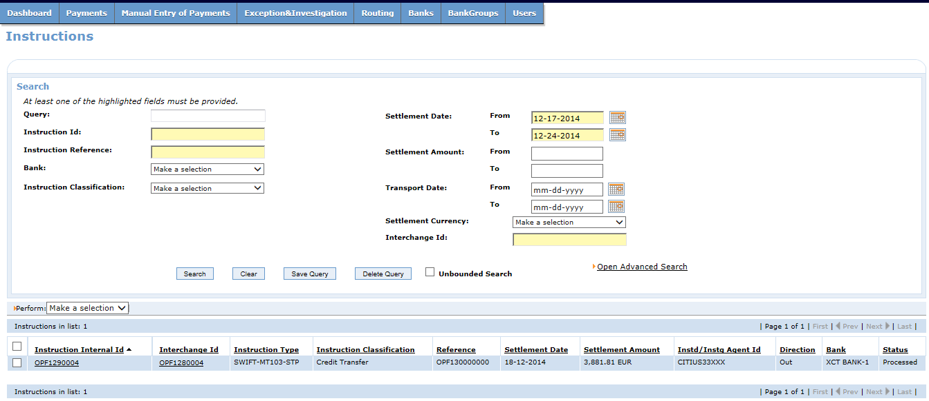
BVA - UI (Instruction Search Screen)
This screen enables a user to search Instructions in the system.
Drill down to the underlying Transaction details.
Sort them on basis of various columns displayed on screen.
Navigate through pages if interchange count exceed then 15.
Save a searched query for a later use.

Slide 22
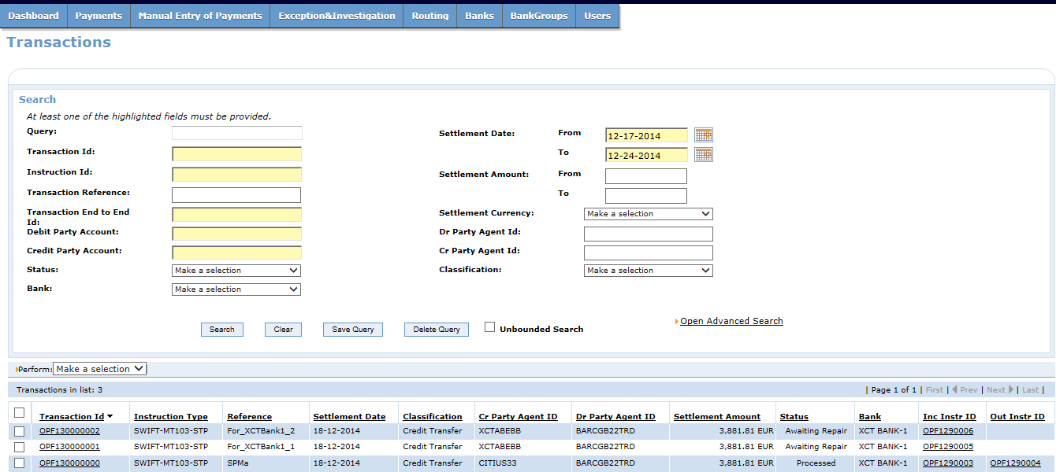
BVA - UI (Transaction Search Screen)
This screen enables a user to search Instructions in the system.
Drill down to the underlying Transaction details.
Sort them on basis of various columns displayed on screen.
Navigate through pages if interchange count exceed then 15.
Save a searched query for a later use.

Slide 23
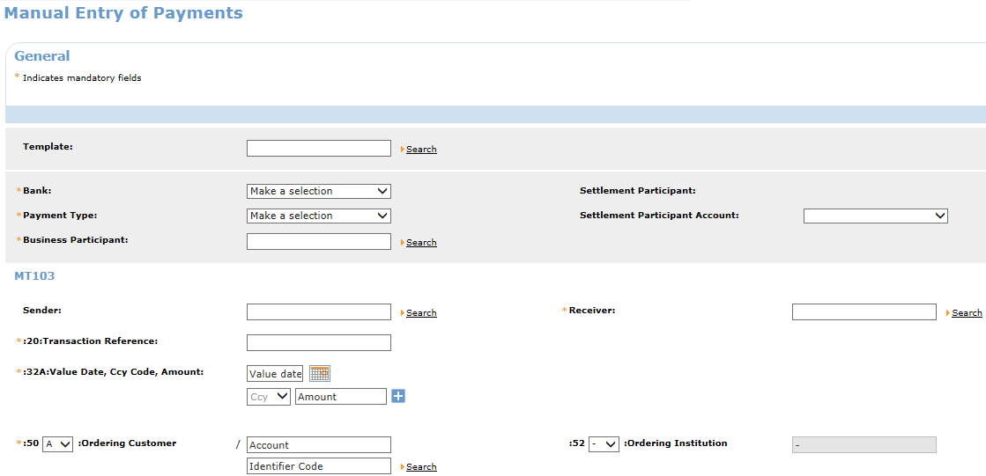
BVA - UI (Manual Entry Screen)
This screen gives the Bank User, a way to create a payment which could be of
MT103 or MT202 ….
Credit Transfer or Financial Institution Credit Transfer.
…Or any other type of Payment messages that the implementation team supports.

Slide 24
Hands On Exercise
TVA Hands On:
Post Swift Interchange Form (MT103)
Config View
Flow Logger
Alter System Time
Toggling Endorsement
Refer the Hands on Excercise File for TVA.
BVA Hands On:
Search and view Interchanges, Instructions and Transactions (MT103)
View Audit Logs
Manual Entry (MT103)
Bank Users
Participants
Refer the Hands on Excercise File for BVA.

Slide 25

Question *A matter requiring resolution or discussion.
Open Your Mind
Widen Your Thoughts

Slide 26
EMEA – Headquarters
Brussels, Belgium
info@clear2pay.com
APAC
Sydney, Australia
info.apac@clear2pay.com
Americas
Atlanta, USA
info.americas@clear2pay.com
www.clear2pay.com

